Slide 1
Seeing IS BELIEVING – ASSISTIVE TECHNOLOGY FOR PARTIALLY SIGHTED

Slide 2
Underlying Problem
Visually impaired individuals, due to deformations in retinal proteins, often struggle with independent living
Question at play: How to address the struggles faced by visually impaired individuals through a technical innovation?

Slide 3
Common Problems for Partially Sighted people
Navigation: This is probably the most critical problem. Navigating outside ( Environmental) as well Navigating inside ( House / Shops / Malls)
Recognition: Identifying the people and places. As they have to rely on the memory of the voice, recognizing the people and places.
Lost: As they move from one place to another, their current position at any time is hard to figure out. They require constant help from others to communicate and trace back.
Communication and Awareness leading to loneliness: As they tend to close their world to very short inner circle, they become immune to what is happening outside. They start living in their own small closed world.

Slide 4
What is my Idea or Innovation?
Mobile App for Visually Impaired persons to address their immediate needs:
Image Recognition: Using the mobile phone camera, Visually impaired person can compare the image and recognize the place or person.
Recognizing the current place and Location thru voice activated Service using Google Map Location Sensor.
Remembering the navigation path, by storing landmarks of navigation in the mobile app.
Using Microsoft Azure Image Recognition / Face recognition software as service for identifying the known and unknown places.

Slide 5
How does it work?
Navigation:
Location Sensor: Google Android Location Sensor can identify the current Latitude, Longitude and Address of any place.
Remembering Location: Using TinyDB in the Mobile App or cloud storage, the location is stored in order.
Traversing back is possible, by selecting the remembered location and current location with the help of Google Map application.
TextToSpeech API makes it easier to communicate through voice from Text.
Current Location is given over the Voice by using TexttoSpeech.

Slide 6
How does it work?
Recognition:
Image selection: Mobile Camera is used to take the picture of people or surroundings.
Image storage: Google Drive is used to upload/Store the Images.
Identifying the Known people and Places: Image comparison is done using the Google Image comparison. New people or known places can be added to the library for future recognition.
Unknown places and Surroundings: Image and Vision analytics provided by Cloud Engine make it easier to identify the image characteristics and convey the same through voice.

Slide 7
What is Image comparison?
Comparing Images was always a challenge and still a challenge. The power of cloud made the image comparison possible.
How are images compared?
Images are stored as pixels with R, G, B ( Red, Green , Blue and intensity). The combination of these make the image.
Images cannot be compared like strings or numerals. For example if we try to compare the picture of a face in front view and side view of the same person, the results would prove to be mismatch.
One common way the cloud engine compares these images is to convert these images to Black and White and compare their intensity in the black and white instead of comparing all combinations of colors.
Images are classified based on their features.
The features are compared to identify the images.
Since the whole logic is provided us to as service by the cloud engine, it is up to us to figure out how do we use these to make the life better for our community?

Slide 8
How does GPS work ?
Locations are identified by the latitude and longitude.
Locations sensor uses the GPS in the Android Phone to identify the current latitude and longitude.
Google maps provide the option to convert the latitude and longitude to address location.
GPS identifies the mapping of any place in the earth by comparing the data from 3 different satellites and uniquely identifies any place in the earth.
As the app stores the latitude and longitude the directions are mapped.

Slide 9
What do I require?
Android Phone
Microsoft Cognitive Services API – Vision / Face APs
MIT Mobile App Inventor
Microsoft Vision API for Image feature analysis
Microsoft Recogntion API for Image Recognition
Mobile App Inventor
Amazon EC2 instance for hosting the web application
PHP IDE
Amazon S3 cloud storage
Any programming Language ( PHP)
Commonly recognized Images

Slide 10
Architecture
Upload images
Amazon Cloud Storage for images ( to get the URL link for the image)
Cloud Web Server
(PHP web application
Mobile App
Microsoft Cloud Vision API
Analyze the image
Interpret the Image
Return it Mobile App
Convert Result to voice
(Text to Speech)
Microsoft Face API
Recognize the face
Verify against the known faces

Slide 11
Technical Drawing
Location Sensor
Camera
Text to Speech
Android Mobile App
Location Sensor – Identifies the Current Latitude and Longitude
Camera - Takes the current picture
Text to Speech - Maps the text to speech for easier communication
Google Map - Traces back the direction
Tiny DB - Remembers the location

Slide 12
Technical Drawing
Call PHP web application hosted in the server
Copy the image to Amazon cloud storage. Create the URL link for the image
Invoke Microsoft Vision API for image analysis
Invoke Microsoft Face API for Face recognition
Image Analysis
Amazon Cloud – Stores the image, and provides the URL link for image
PHP program - Calls Cloud Cognitive services and interpret the results.
Vision API - Microsoft Cloud service interprets the image
Face API - Microsoft Cloud Service recognize and verifies the face

Slide 13
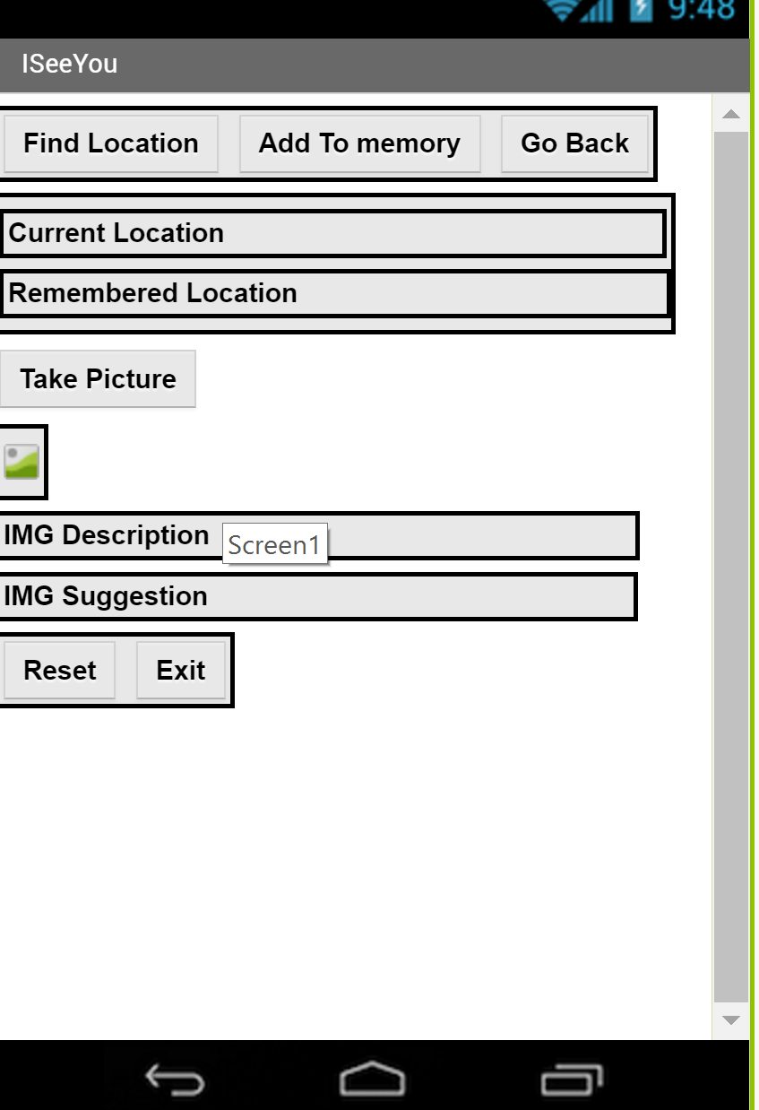
Mobile App Prototype model built
Voice activated buttons for controls
Labels for display – Voice controlled as well
Image Analysis.
Predictive suggestion based on the image analysis.
Activity Component Controls

Slide 14
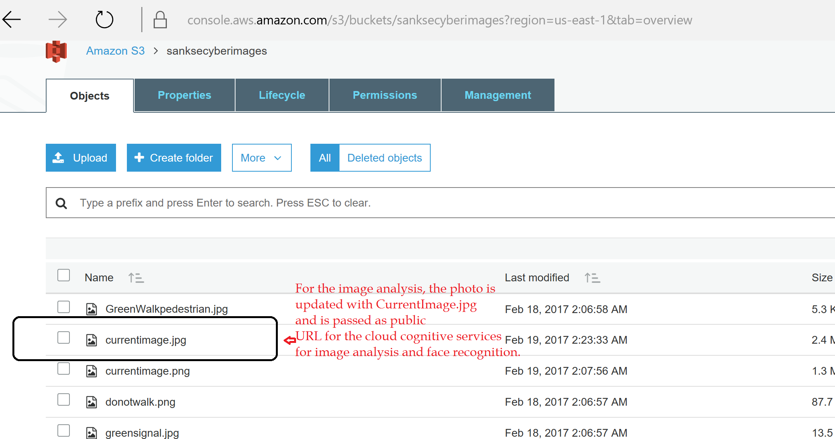
Amazon Cloud storage for images

Slide 15
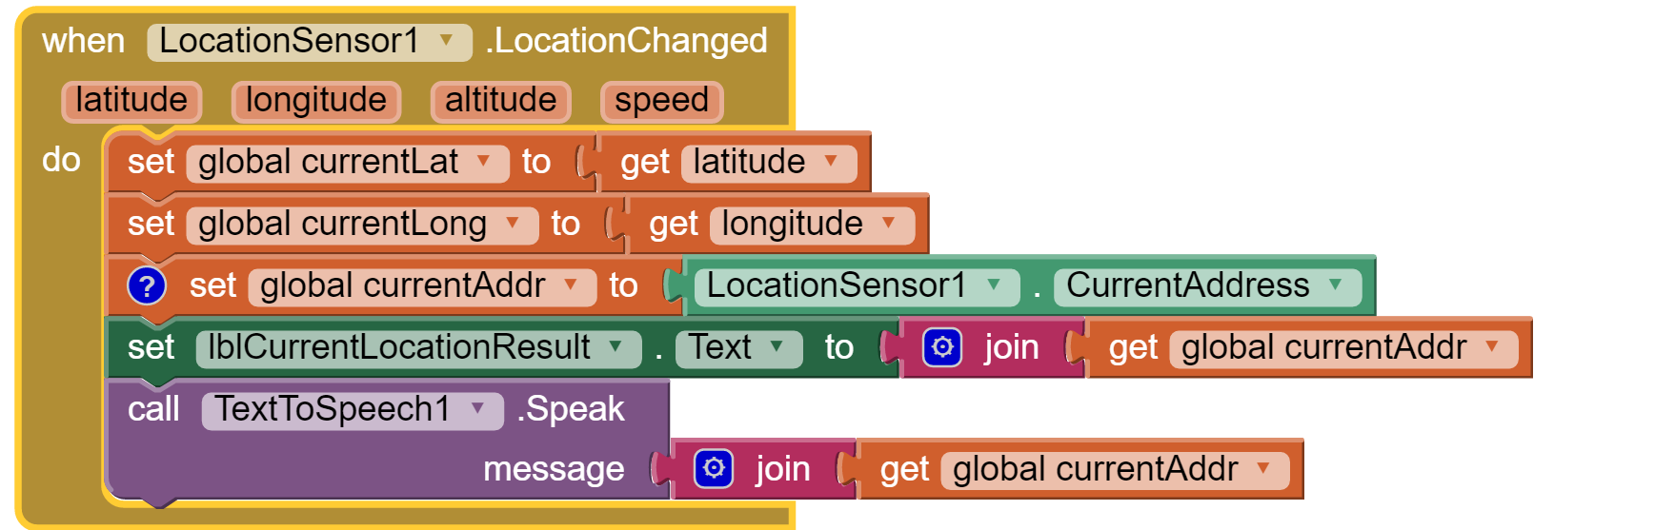
MIT Mobile App Inventor – Design block for Location Sensor Voice activation of Address information

Slide 16
Image analysis – Invoking Web PHP
http://52.202.165.214/vision1.php?fn=

Slide 17
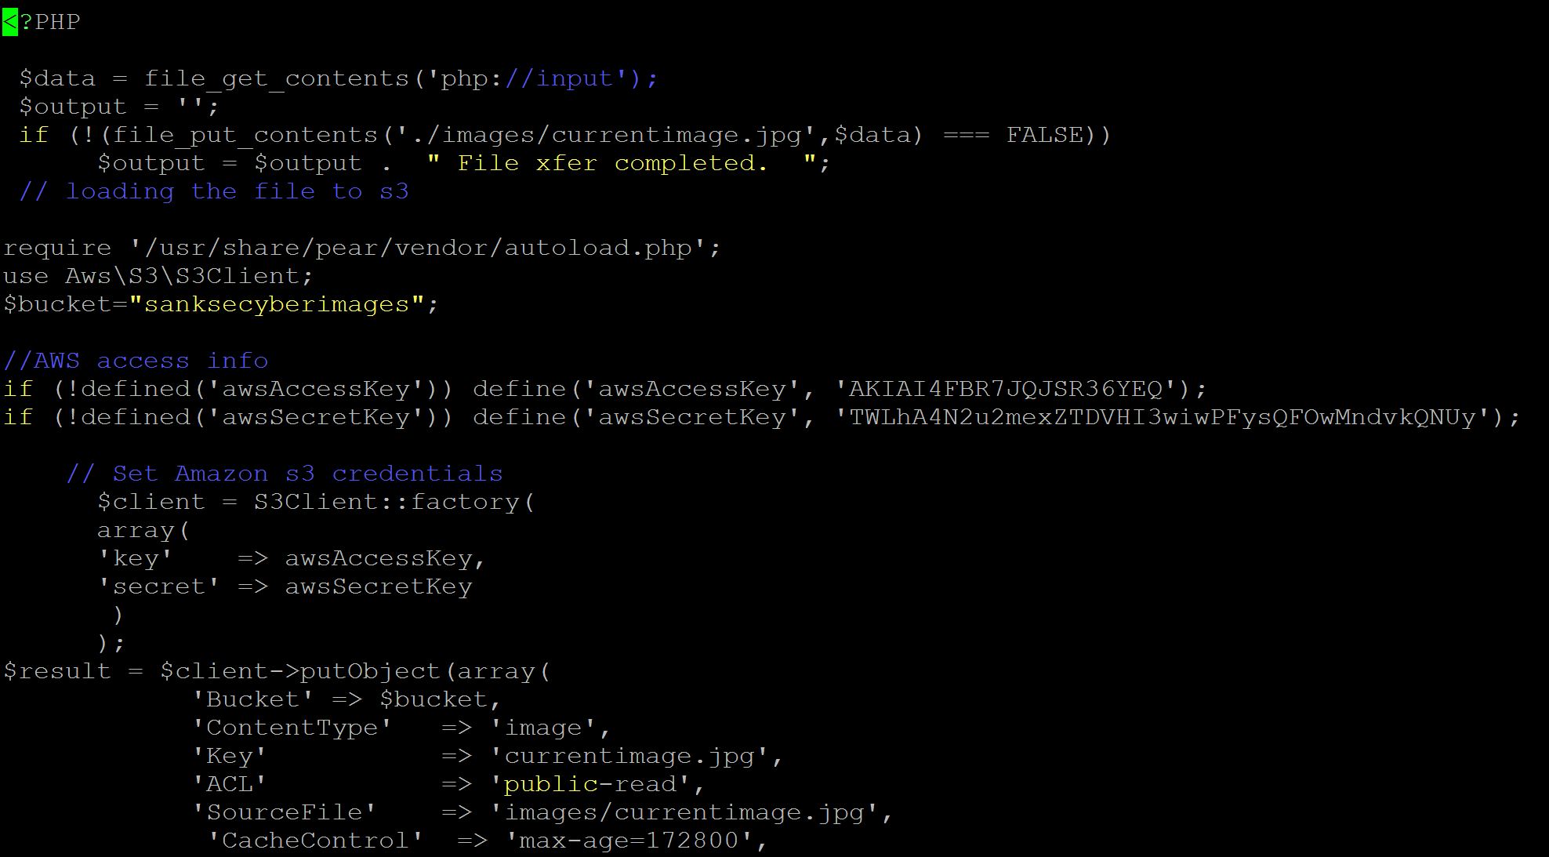
PHP web application for image analysis

Slide 18
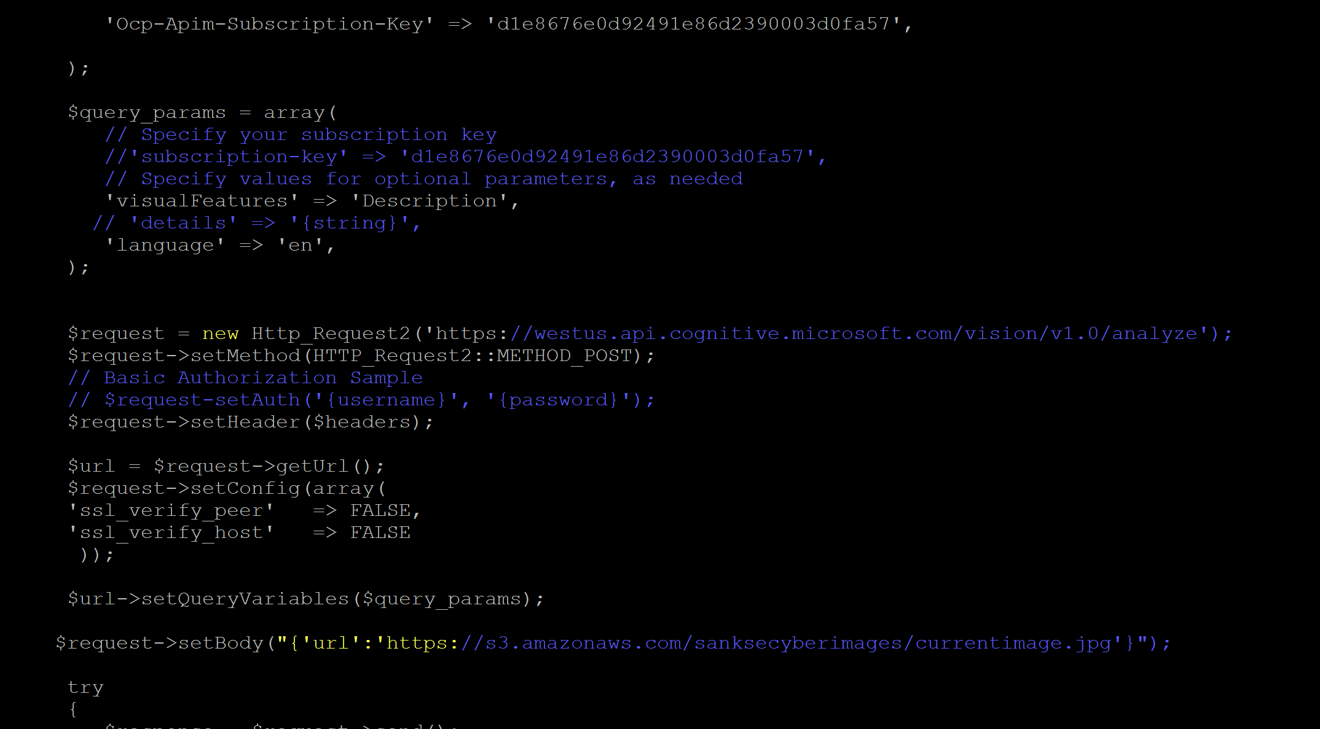
PHP web application continued

Slide 19
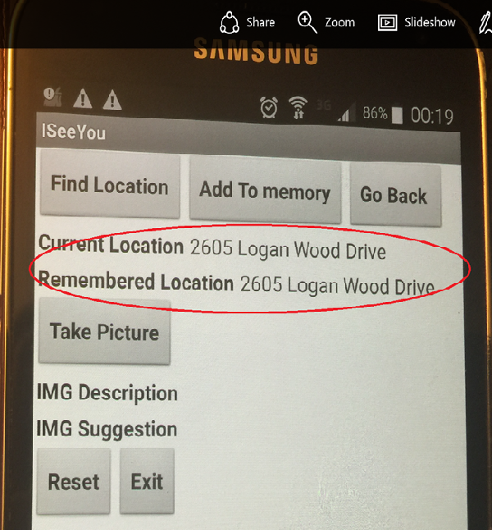
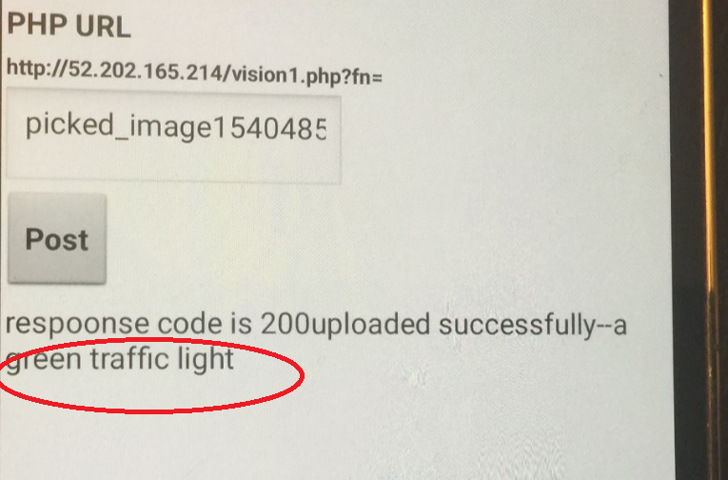
Mobile app result pictures
Result : Display of current locations
Display of remembered location
Result : Display of image analysis result

Slide 20
Face recognition and Identification using Cloud Face API
$headers = array(
// Request headers
'Content-Type' => 'application/json',
'Ocp-Apim-Subscription-Key' => '61646d3654eb4c7792e6538ac0b52c86',
);
$request->setHeader($headers);
$url = $request->getUrl();
$request->setConfig(array(
'ssl_verify_peer' => FALSE,
'ssl_verify_host' => FALSE
));
$parameters = array(
// Request parameters
'returnFaceId' => 'true',
'returnFaceLandmarks' => 'false',
'returnFaceAttributes' => 'age,gender',
);
$url->setQueryVariables($parameters);
$request->setMethod(HTTP_Request2::METHOD_POST);
$request->setBody("{'url':'https://s3.amazonaws.com/sanksecyberimages/currentface.jpg'}");
try
{
$response = $request->send();
// echo $response->getBody();
$data_json = json_decode($response->getBody());
// echo(var_dump($data_json));
// $image_description = $data_json[0]->faceId;
$image_description = 'It is ' . $data_json[0]->faceAttributes->gender . ' of roughly aged ' . strval(round($data_json[0]->faceAttributes->age));

Slide 21
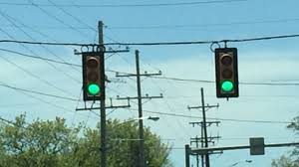
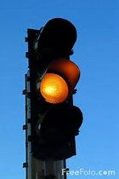
Experiment Results
Result : Green Traffic light
Accent color : Green
Suggestion: Traffic signal with dominant color as blue and accent color as green.
Experiment success/failure: Success
Result : Identifies it as close up traffic signal.
Accent color : Not Green/Red
Suggestion: Traffic signal with dominant color as blue and accent color as brown.
Experiment success/failure: Success

Slide 22
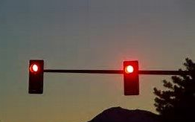
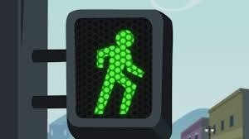
Experiment Results
Result : a red stop light at sunset. Accent color : Red
Suggestion: Main road traffic is in stopped.
Experiment success/failure: Success
Result : Identifies it as traffic light.
Accent color : Green
Suggestion: Hard to give suggestion
Experiment success/failure: Failure ( As human crossing wasn’t recognized)

Slide 23
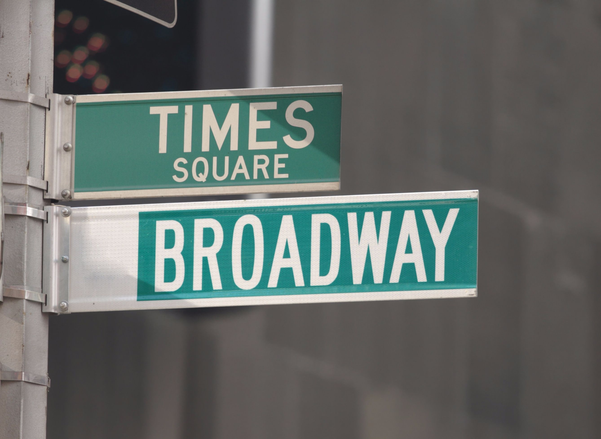
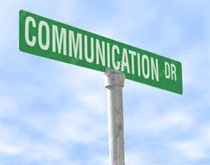
Experiment Results
Result : Street sign with Text
Times square broadway
Accent color : Green
Suggestion: Name of the street sign
Experiment success/failure: Success
Result : None
Accent color : Green
Suggestion: Hard to give suggestion
Experiment success/failure: Failure ( Wasn’t able to read in orientation)

Slide 24
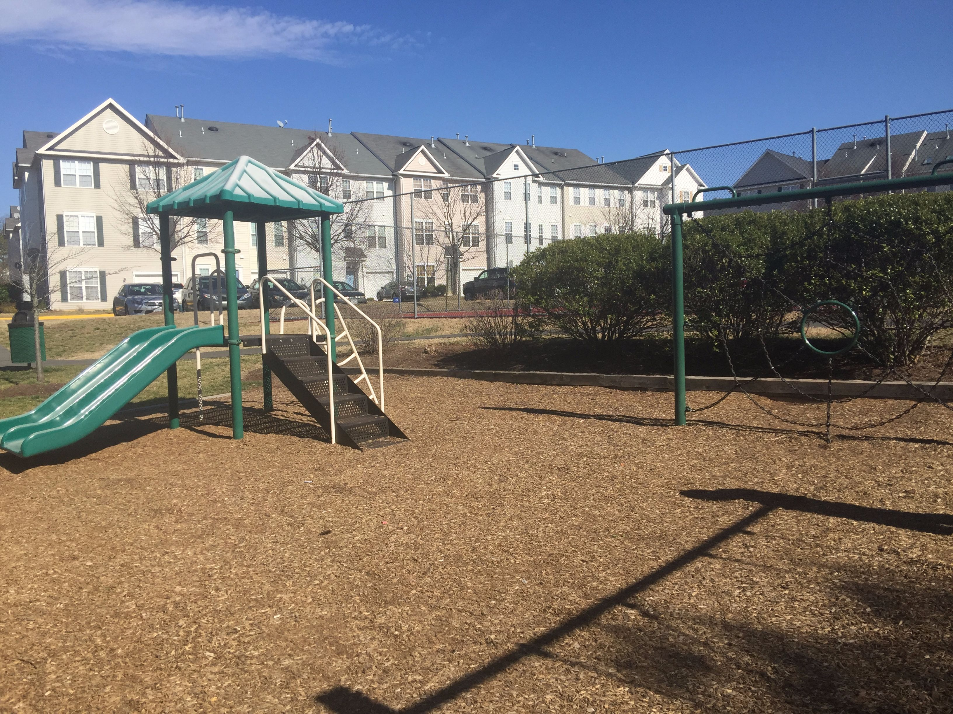
Experiment Results
Result : House and Playground Suggestion: even background images are analyzed
Experiment success/failure: Success
Result : a red stop sign in front of a building
Suggestion: even background images are analyzed
Experiment success/failure: Success

Slide 25
Experiment results
Result : Fenced area
Suggestion: Was able to identify the fenced play area
Experiment success/failure: Success
Result : an empty park bench next to a forest
Suggestion: Was able to identify background and the bench
Experiment success/failure: Success

Slide 26

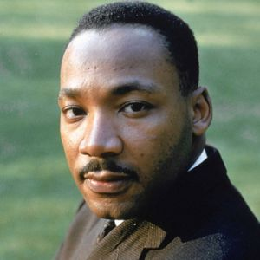
Recognizing People
Output: It is female of roughly aged 26
Person: unknown
Result: Success
Output: It is male of roughly aged 31
Person: unknown
Result: Success
(Face API provides an option to know the known celebrities ). Our tool can be enhanced to include the known famous people

Slide 27
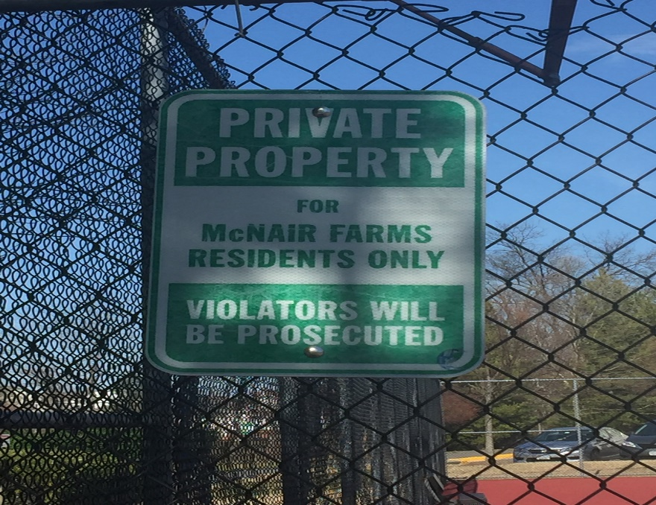
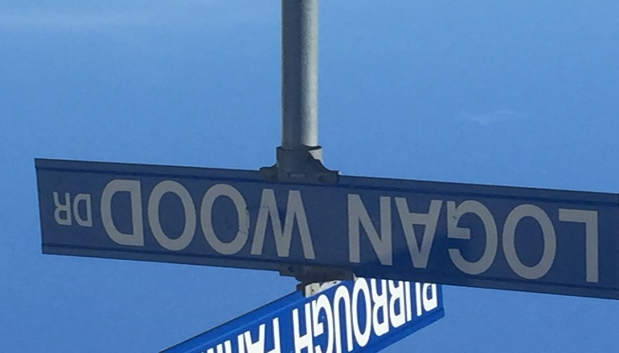
Output: Not able to read the Text
Result: Failure
Lighting on the picture made the difference in this case
Output: Not able to read the Text
Result: Failure
The orientation and background didn’t allow the OCR to read the letters

Slide 28
Cost Involved
Google drive ( free trial version)
Azure free Trial version
(After trial, the storage is in cents for each GB per month)
Azure Cognitive services ( free trial)
Amazon Storage ( Free Tier)
I have my own laptop for building the model and try out.
Android Phone which I already own
Model was built with the cloud free tier , once the free tier is over, it would incur nominal cost based on the usage.

Slide 29
Challenges and ideas to ponder
Image comparison - does it always work?
Image comparison and recognition is growing area of research. Even though it has come a long way, it is not 100% accurate. It is evolving rapidly as the day progress, and the results would be better. Currently the power of cloud makes it possible, but it still has a long way to go to make it completely successful.
Can we recognize the Letters and numbers in the images?
This is known as OCR ( Optical character recognition). The standard characters can be recognized through OCR, but the variation in type of letters and languages are immense. So this is still evolving area.
Is there any delay in conveying the results?
Yes. It depends on the speed of the mobile connection and the response from the cloud engine. If there is no internet connection, then it would still be challenge.

Slide 30
Ideas to Enhance
Reading the text and images in Tilted Angle
As the app depends on the image and OCR through the image, it was able interpret with 80% confidence on the direct images, but if the image is tilted then the recognition was a challenge. It wasn’t able to read the letters and texts clearly. Even on the cross signal, mapping the one direction over the other was a challenge. A visually challenged person would be able to interpret , but if the person is totally blind, it would be kind of hard to map the direction and orientation.
Mapping the known places and surroundings.
Image comparison was a challenge. If the person has to recognize the known home environment, the image comparison depends on the angle in which the image was captured. It works better for straight images compared to tilted images.
Internet Connectivity?
As it depends on the Amazon cloud and Vision/Face API in the cloud, the internet connectivity is critical. If no connectivity , it would be a challenge.

Slide 31
References
http://www.fairfaxcounty.gov/dfs/disabilities/complete-guide-to-services.htm ( Learning for the visually impaired persons)
http://www.fairfaxcounty.gov/oem/prepare/disabilities.htm ( Fairfax county special needs program)
http://www.tsbvi.edu/program-and-administrative-resources/3247-the-unique-needs-of-the-visually-impaired-infant ( Nations leading school for visually impaired learning)
http://visuallyimpairedpeople.org/ ( Assoiciation of visually impaired people)
http://www.afb.org/default.aspx (American Association for blind)
http://www.visionaware.org/default.aspx (Independent living for visually impaired)
http://www.pathstoliteracy.org/overview-assistive-technology ( Assistive technology for visually impaired)
https://appadvice.com/applists/show/apps-for-the-visually-impaired ( App advice for blind and visually impaired)
https://www.tensorflow.org/tutorials/image_recognition ( Image recognition software and trends)

Slide 32
References
Journals and papers:
https://www.fhwa.dot.gov/advancedresearch/pubs/15040/15040.pdf - Assistive technology trends
Feature extraction and image recognition
Algebraic feature extraction of image for recognition
http://www.sciencedirect.com/science/article/pii/003132039190063B
Traffic and Car plate recognition image extraction
http://ieeexplore.ieee.org/document/703970/

